Slide 1
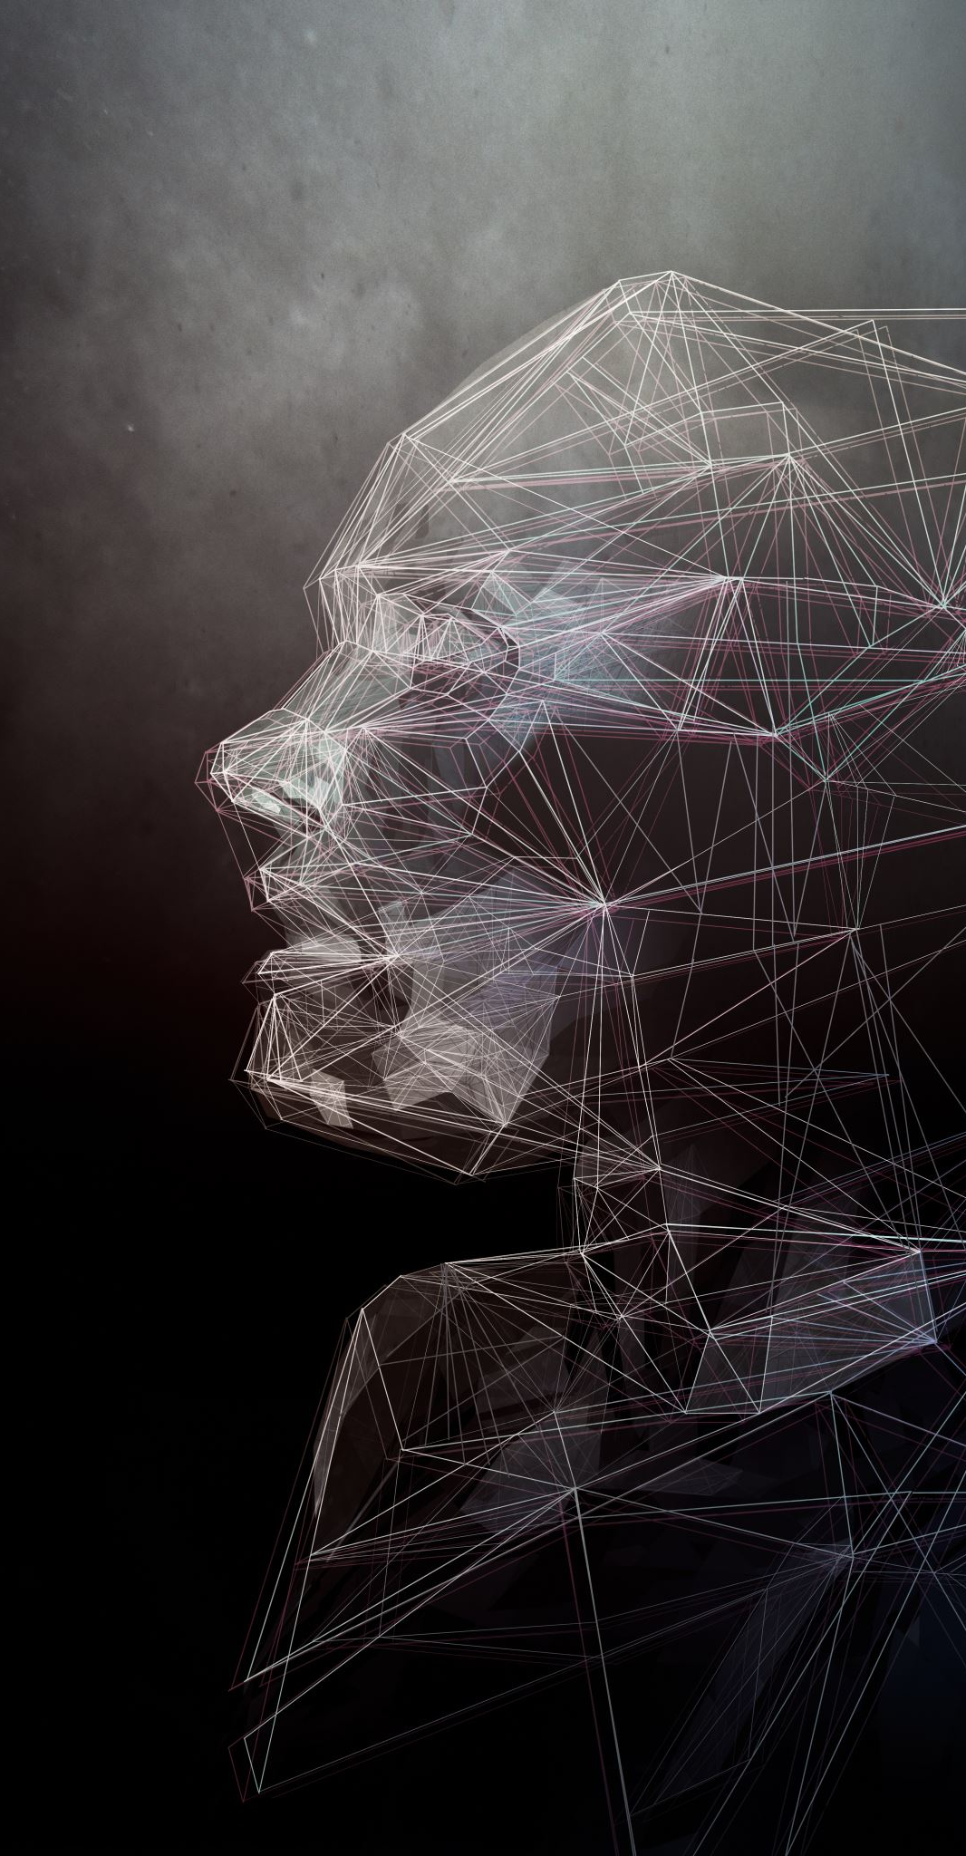
Facial Recognition
Gang Wang
Yunjie Xiong
Zhenyu Zhang
EAI 6080 - Advanced Analytical Utilization

Slide 2

Background
Facial Recognition has been used in many aspect
In Security: Identify people’s information
In entertainment: predict the feature of facial picture
Our project is to make an entertainment Tool
In social media application: predict the age, race, and gender of facial picture to give people more topic to shorten distance between people

Slide 3
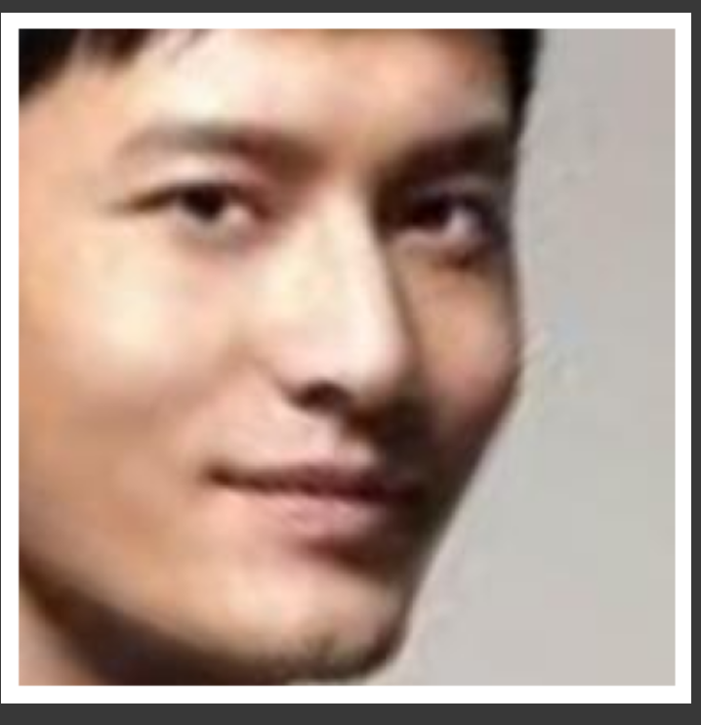
Dataset
Our data “UTKFACE” is from Kaggle
There are 23705 picture
The label contains age, gender, and race
Age is from 1 to 116
Gender is male and female
Race contain White, Black, Asian, Indian, Others
https://susanqq.github.io/UTKFace/

Slide 4
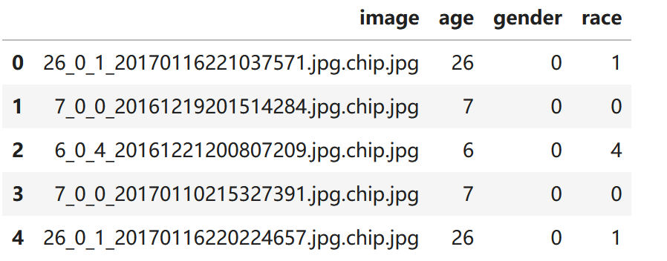
Preprocess
Clean the dataset:
Make DataFrame to collect labels
Clean outliers
Solved unbalance problem in dataset
Make the maximum number of picture for each age to be 500
Align and crop images
Use OpenCV in cuda
Use distance between eyes to align and crop
Use Clahe: Histogram Equalization to increase the tiles of picture to increase light
Switch to NumPy array

Slide 5
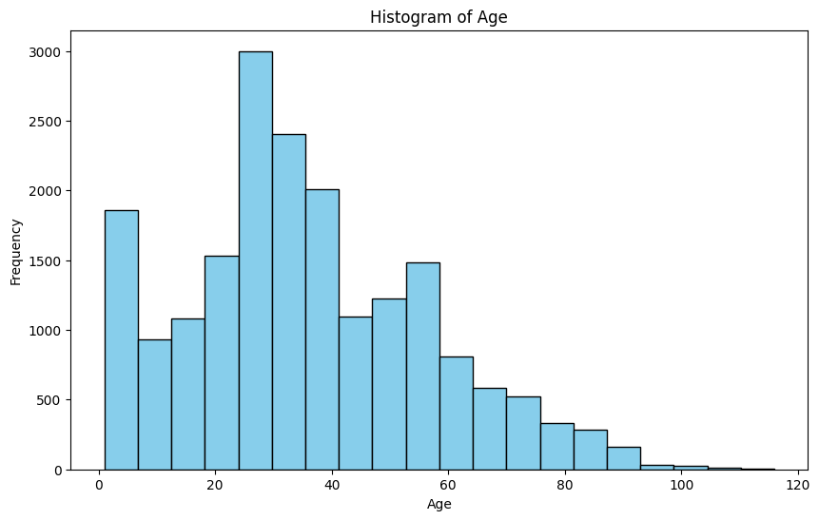
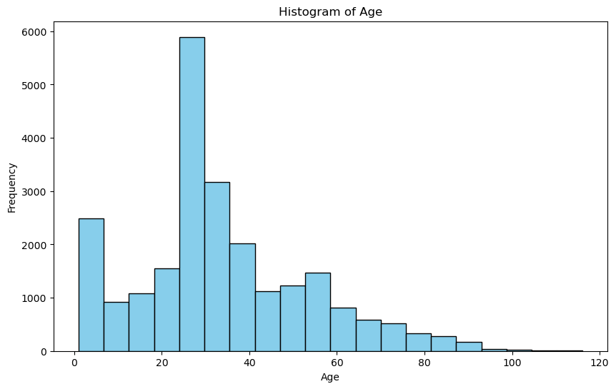
EDA

Slide 6
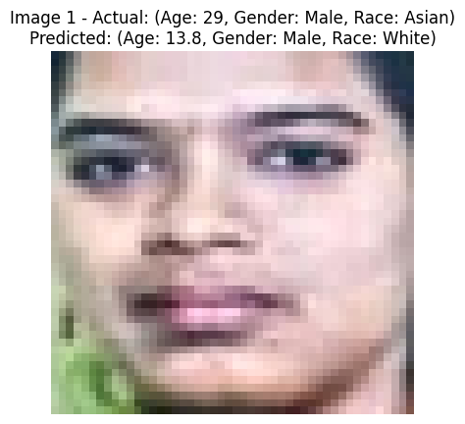
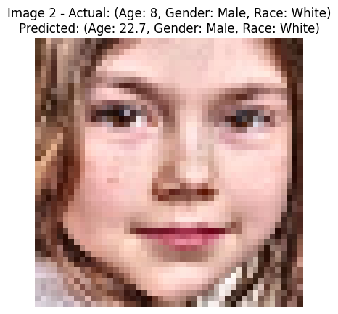
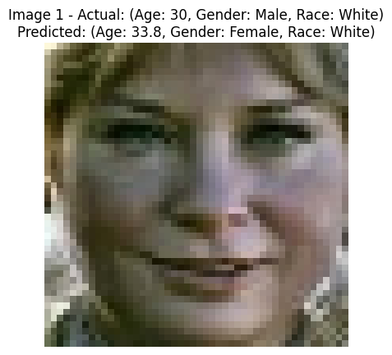
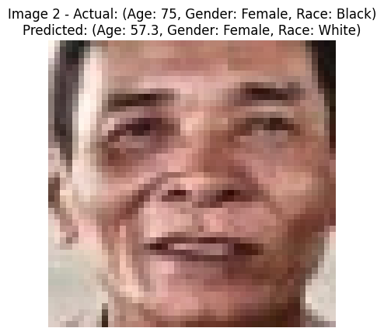
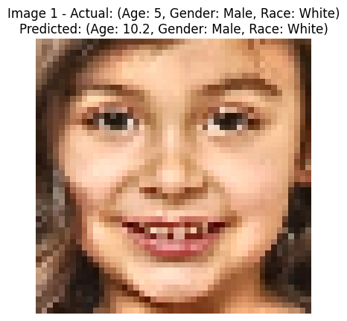
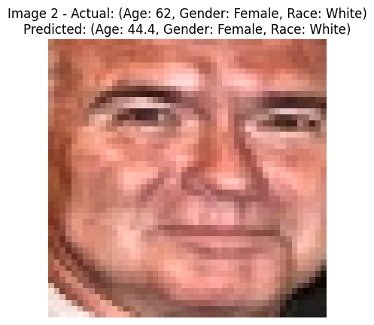
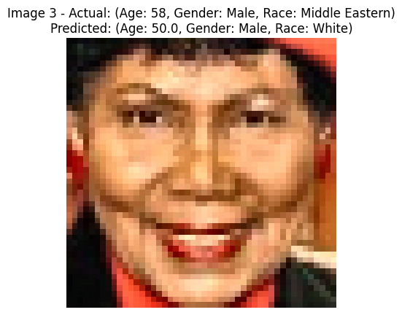
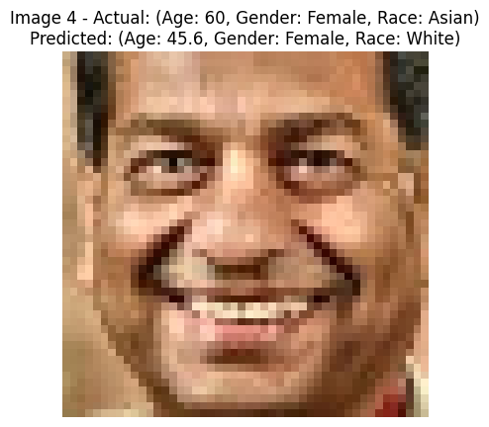
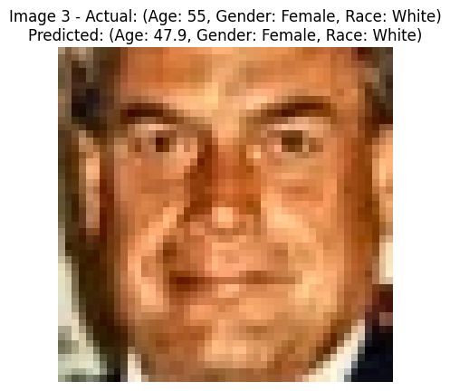
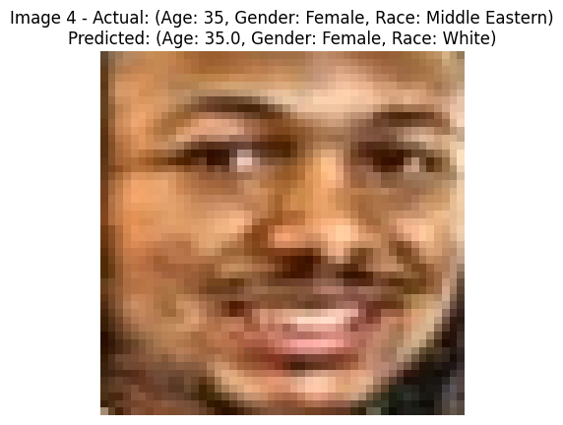
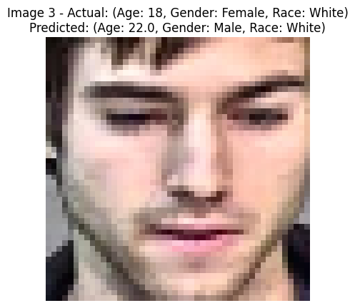
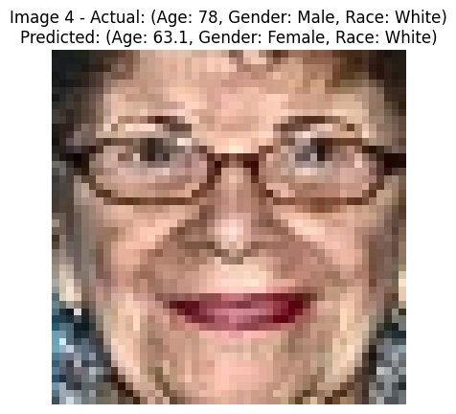
Model results
SVM
Random Forest
CNN

Slide 7
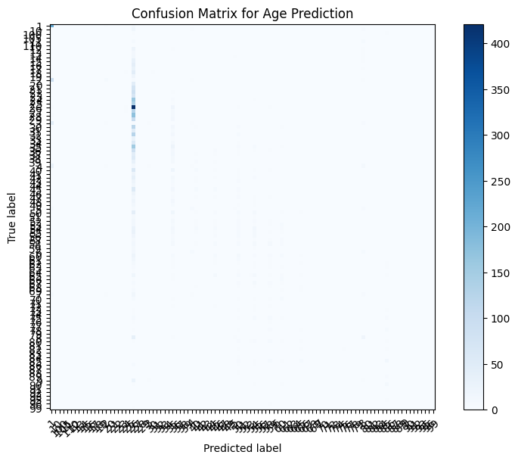
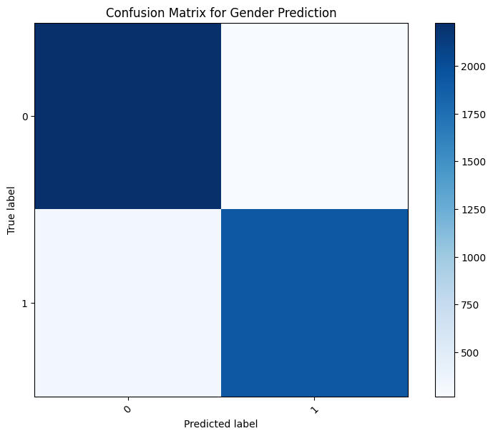
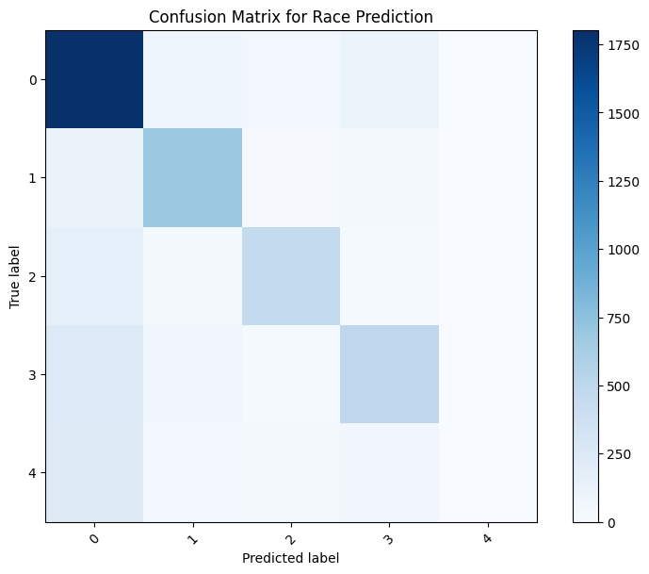
SVM
Accuracy: 72.5%

Slide 8
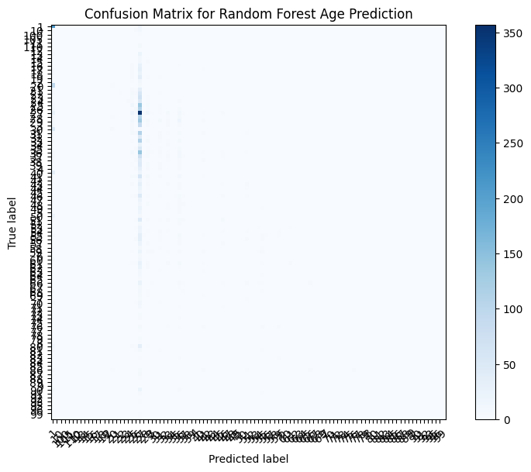
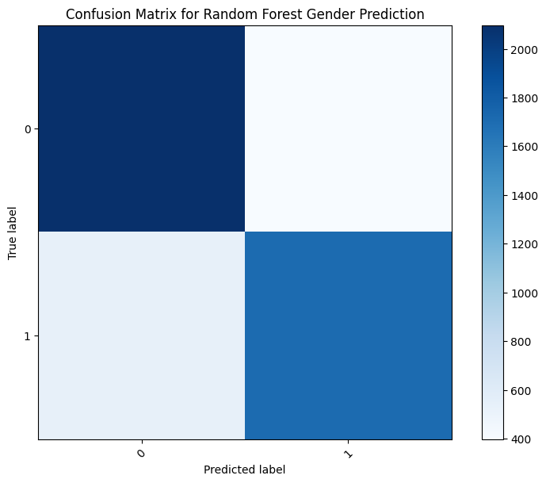
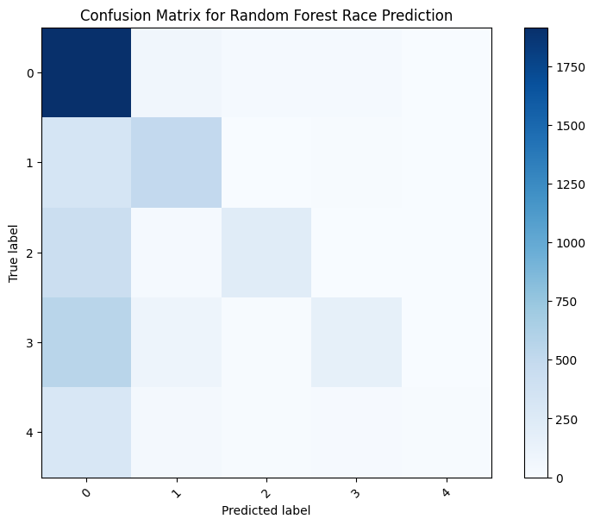
Random Forest
Accuracy: 59.2%

Slide 9
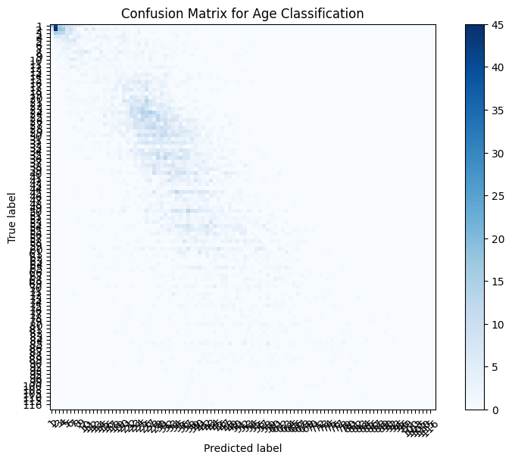
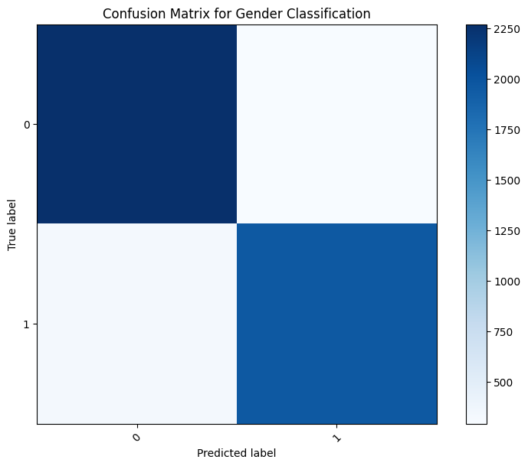

Simple CNN
Accuracy: 63%

Slide 10
Optimizer
Deep Model Architecture Improvement
Increased Convolutional Layers: The number of convolutional layers has been increased to four layers to enhance the model's feature extraction capabilities.
Hyperparameter Tuning
Dynamic Learning Rate Adjustment: Introduced the ReduceLROnPlateau callback function.
Multi-task Loss Function: For gender prediction, binary cross-entropy is used as the loss function for the binary classification task, Mean Squared Error (MSE) is employed for age prediction as a regression task, and sparse categorical cross-entropy is utilized for race prediction in the multi-class classification task.
Specific Output Layers for Each Task：The Sigmoid activation function is used for gender prediction, the ReLU activation function is applied for age prediction to ensure non-negative values, and the Softmax activation function is utilized for race prediction to output the probability distribution over race categories.
Ensemble Modeling Approach
Independent Model Training: Separate models are trained for each prediction task (gender, age, and race) instead of a single model handling all tasks simultaneously.
Ensemble Prediction Mechanism:The predicted values from all models are averaged to obtain a more accurate age prediction. A voting mechanism is employed to calculate the vote results at each position, determining the final outcome based on majority voting.

Slide 11
Comparison
 | Precision | Recall | F1-Score | Accuracy
SVM | 0.06 | 0.14 | 0.06 | 0.1428
Random Forest | 0.07 | 0.13 | 0.05 | 0.1257
CNN | 0.65 | 0.60 | 0.62 | 0.63
Integrated Model | 0.75 | 0.72 | 0.70 | 0.75
Age
 | Precision | Recall | F1-Score | Accuracy
SVM | 0.65 | 0.64 | 0.64 | 0.66
Random Forest | 0.72 | 0.70 | 0.71 | 0.73
CNN | 0.66 | 0.65 | 0.65 | 0.66
Integrated Model | 0.87 | 0.87 | 0.87 | 0.87
Gender
 | Precision | Recall | F1-Score | Accuracy
SVM | 0.61 | 0.66 | 0.62 | 0.6579
Random Forest | 0.52 | 0.50 | 0.41 | 0.5037
CNN | 0.46 | 0.23 | 0.17 | 0.47
Integrated Model | 0.73 | 0.64 | 0.65 | 0.72
Race

Slide 12
Conclusion
In general, Random Forest lagged behind CNN and the Integrated Model, especially when it came to racial classification. While CNN performed well on age prediction but poorly on racial classification, SVM performed moderately well on gender and race tasks but poorly on age prediction.
The integrated model outperformed all other models on the task, especially in age and gender classification.

Slide 13
Recommendation
Focus on Ensemble Methods and Optimization: Improving the Integrated Model by incorporating boosting or stacking techniques and adjusting model weights according to specific task performance can enhance overall predictive accuracy in age and gender classification.
Improve CNN Performance in Race Classification: Enhancing CNN's effectiveness for race classification can be achieved by adopting deeper architectures, implementing data augmentation to enrich training data diversity, and utilizing efficient loss functions like weighted cross-entropy to address class imbalance.

Slide 14
References
Bhattacharyya, S. (2011). A brief survey of color image preprocessing and segmentation techniques. Journal of Pattern Recognition Research, 1(1), 120-129.
Boughorbel, S., Tarel, J. P., & Boujemaa, N. (2005, July). Conditionally positive definite kernels for svm based image recognition. In 2005 IEEE International Conference on Multimedia and Expo (pp. 113-116). IEEE. https://doi.org/10.1109/ICME.2005.1521373
Chauhan, R., Ghanshala, K. K., & Joshi, R. C. (2018, December). Convolutional neural network (CNN) for image detection and recognition. In 2018 first international conference on secure cyber computing and communication (ICSCCC) (pp. 278-282). IEEE. https://doi.org/10.1142/S0218127497001618
Kaur, P., Krishan, K., Sharma, S. K., & Kanchan, T. (2020). Facial-recognition algorithms: A literature review. Medicine, Science and the Law, 60(2), 131-139.
https://doi.org/10.1177/0025802419893168
Kremic, E., & Subasi, A. (2016). Performance of random forest and SVM in face recognition. Int. Arab J. Inf. Technol., 13(2), 287-293.
Liu, Y., Wang, Y., Yu, R., Li, M., Sharma, V., & Wang, Y. (2019). Optimizing {CNN} model inference on {CPUs}. In 2019 USENIX Annual Technical Conference (USENIX ATC 19) (pp. 1025-1040).
Poojary, R., & Pai, A. (2019, November). Comparative study of model optimization techniques in fine-tuned CNN models. In 2019 International Conference on Electrical and Computing Technologies and Applications (ICECTA) (pp. 1-4). IEEE. http://doi.org/10.1109/ICECTA48151.2019.8959681.

Slide 15
Thank you

